Slide 1


SUPERVISED BY
Dr. D. DhinaKaran, M.E., Ph.D.
PRESENTED BY
1. Lokeshwar (22202)(22UECS0366)
2. Sushma (21849)(22UECS0325)
3. Deekshitha (21745)(22UECS0645)

Slide 2
MediXpert Application
AGENDA
Introduction
Literature Survey
Problem Statement
Proposed Methodology
Proposed System Architecture
Implementation Details
Testing & Validation
Preliminary Results & Analysis
Conclusion and Future Work
References

Slide 3
Introduction
Problem Statement:
Early and accurate diagnosis of medical conditions like brain tumors, pneumonia, and bone fractures is critical for effective treatment. However, the current healthcare system faces several challenges:
Human Error: Manual analysis of medical images (e.g., MRI, X-rays) can lead to misdiagnosis.
Time-Consuming Process: Diagnosing diseases manually takes significant time, delaying treatment.
Lack of Access to Specialists: In remote or underserved areas, access to radiologists and specialists is limited.
Increasing Workload: With the growing number of patients, healthcare systems are overburdened.

Slide 4
Project Goal:
The Medixpert Application aims to revolutionize medical diagnostics by leveraging Artificial Intelligence (AI) and Machine Learning (ML) to address critical challenges in healthcare.
Specifically, the project focuses on:
Automating Disease Detection
Improving Diagnostic Accuracy Convolutional Neural Networks (CNN)
Enhancing Accessibility
Reducing Diagnosis Time
Scalability and Future Expansion

Slide 5
Brief Overview:
Medixpert is an innovative AI-powered application designed to transform the way medical diagnostics are performed.
Brain Tumor Detection:
Medixpert analyzes MRI scans to identify the presence, location, and size of brain tumors.
Pneumonia Detection:
The application processes chest X-rays to detect signs of pneumonia, a common and potentially life-threatening respiratory condition.
Bone Fracture Detection:
Medixpert examines X-ray images to identify fractures in bones, providing detailed insights into the type and severity of the injury.

Slide 6
Literature Survey
Existing Systems:
In the current medical diagnostic system, bone fractures and pneumonia are primarily detected through traditional radiographic imaging methods such as X-rays, CT scans, and MRIs. Radiologists and medical professionals manually analyze these images to diagnose fractures and lung infections. While this method is effective, it has several limitations:
Time-Consuming – Manual analysis of medical images is slow, leading to delays in diagnosis and treatment.
Human Error – Misinterpretation of X-rays and scans due to fatigue or expertise level differences can lead to misdiagnosis.
Lack of Automation – Existing systems do not leverage AI or ML for automated detection, requiring complete reliance on human expertise.

Slide 7
Related works:
Several research studies and AI-driven medical applications have been developed to address the limitations of traditional diagnostic systems. Some notable works include:
AI in Medical Imaging – AI models, such as convolutional neural networks (CNNs), have been extensively studied for medical image analysis, showing promising results in fracture and lung disease detection. These models automate the process of feature extraction and classification, significantly improving diagnostic accuracy.
Brain Tumor Detection using CNNs – Research has demonstrated the effectiveness of CNN-based models in automatically detecting and segmenting brain tumors in MRI images. These models achieve high accuracy in distinguishing between benign and malignant tumors.
Pneumonia Detection using Deep Learning – Deep learning models, particularly CNNs, have been widely used for detecting pneumonia in chest X-ray images. These models outperform traditional methods by accurately classifying viral and bacterial pneumonia.
Computer-Aided Diagnosis (CAD) Systems – CAD tools have been used in medical imaging to assist radiologists by highlighting potential abnormalities in X-rays, MRIs, and CT scans. These systems improve diagnostic efficiency and reduce human error.

Slide 8
Problem Statement
Early and accurate diagnosis of medical conditions like brain tumors, pneumonia, and bone fractures is crucial for effective treatment.
Manual Diagnosis:The process is time-consuming, delaying critical treatment for patients.
Limited Access to Specialists:In remote or underserved areas, access to skilled radiologists is often limited, resulting in delayed or missed diagnoses.
High Costs:Advanced diagnostic tools and expert consultations are expensive, making them inaccessible to many patients.
Increasing Workload:With the growing number of patients, healthcare systems are overburdened, leading to longer wait times and reduced accuracy.
Lack of Scalability:Existing solutions are often not scalable and cannot handle the increasing volume of medical imaging data efficiently.

Slide 9
Proposed Methodology
The proposed methodology for mediXpert involves the integration of advanced machine learning (ML) techniques to enhance the accuracy, speed, and reliability of disease detection for bone fractures and pneumonia.
The methodology includes the following steps:
Data Collection & Preprocessing
Feature Extraction & Selection
Machine Learning Model Development
Model Optimization & Validation
Integration with a User Interface (UI)
Deployment & Future Enhancements

Slide 10
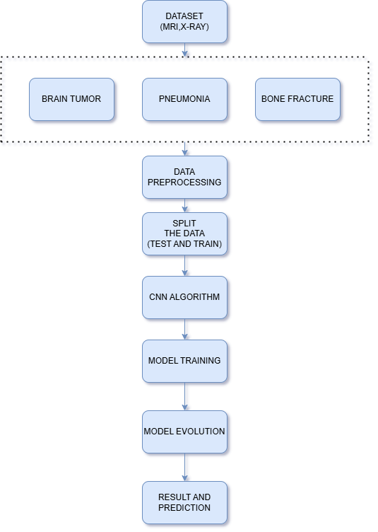
Proposed System Architecture
The proposed system architecture for the MediXpert Application is designed to provide an efficient and accurate AI-powered medical diagnostic tool. The system is divided into four main modules: Image Upload and Preprocessing, CNN-Based Detection Models, Result Interpretation and Visualization, and Report Generation. The CNN-Based Detection Models module consists of three specialized pre-trained CNN models for brain tumor detection, pneumonia detection, and bone fracture detection. These models are fine-tuned using transfer learning and trained on medical datasets to ensure high accuracy. Finally, the Report Generation module creates detailed diagnostic reports with confidence scores, recommendations, and precautions, which can be downloaded or shared with healthcare professionals.

Slide 11
Summary of Module -1
1. Image Upload and Preprocessing Module:
Handles the uploading of medical images and prepares them for analysis by the CNN models.
File Upload:
Accepts medical images in formats like JPEG, PNG, and DICOM.
Validates file type and size to ensure compatibility.
Provides feedback to the user if the file is invalid or unsupported.
Unique Filename Generation:
Uses uuid to generate unique filenames for uploaded images.
Prevents filename conflicts and ensures secure file storage.
Image Preprocessing:
Resizes images to the required dimensions (e.g., 150x150) for model input.
Normalizes pixel values to a range of [0, 1] for better model performance.
Converts images to NumPy arrays for compatibility with TensorFlow/Keras models.

Slide 12
Summary of Module -2
2. CNN-Based Detection Module:
Contains the CNN models for detecting brain tumors, pneumonia, and bone fractures.
Model Loading:
Loads pre-trained CNN models for each detection task.
Ensures models are loaded only once during application startup for efficiency.
Prediction:
Runs the preprocessed image through the appropriate model.
Returns the prediction result as a probability score (e.g., 0.85 for 85% confidence).
Model-Specific Input Requirements:
Ensures each model receives input in the correct format (e.g., resized and normalized images).
Performance Optimization:
Uses GPU acceleration (if available) for faster inference.

Slide 13
Summary of Modules -3
3.Result Interpretation Module Purpose:
Interprets the prediction results and generates user-friendly outputs.
Result Interpretation:
Converts raw prediction probabilities into meaningful results (e.g., "Affected" or "Healthy").
Confidence Scores:
Calculates accuracy and damage percentages based on prediction probabilities.
Displays confidence scores in a user-friendly format (e.g., "95% Confidence").
Recommendations and Precautions:
Provides tailored recommendations based on the diagnosis.
Suggests precautions to prevent further complications.
Condition-Specific Outputs:
Customizes outputs for each condition (brain tumor, pneumonia, bone fracture).

Slide 14
Summary of Modules -4
4. Report Generation Module:
Generates a detailed diagnostic report based on the detection results.
Report Content:
Includes detection results (e.g., "Brain Tumor Detected").
Displays confidence scores and highlighted images.
Provides a summary of findings and recommendations.
Export Options:
Allows users to download the report in PDF or other formats.
Generates reports with a professional layout and branding.
Customization:
Enables doctors to add notes or comments to the report.
Supports multi-language reports for broader accessibility.

Slide 15
Summary of Modules -5
5. User Interface (UI) Module:
Provides an intuitive and user-friendly interface for interacting with the application.
Dashboard:
Displays a summary of recent uploads and detection results.
Image Upload Interface:
Offers a drag-and-drop or file picker interface for uploading medical images.
Displays a preview of the uploaded image for verification.
Result Display:
Shows annotated images and detection results in a clean, organized layout.
Accessibility:
Supports keyboard navigation and screen readers for visually impaired users.

Slide 16
Implementation Details
1. Data AcquisitionTo collect and store medical imaging data for training and testing the CNN models.
Brain Tumor Detection:
Public datasets like the BraTS (Brain Tumor Segmentation) dataset.
Collaborations with hospitals and medical institutions for MRI scans.
Pneumonia Detection:
Public datasets like the ChestX-ray8 dataset or Kaggle's Chest X-Ray Images (Pneumonia) dataset.
Chest X-rays from medical imaging archives.
Bone Fracture Detection:
Public datasets like the MURA (Musculoskeletal Radiographs) dataset.
X-ray images from orthopedic clinics and hospitals.
Data Formats:
MRI scans: DICOM or NIfTI formats.
X-rays: JPEG or PNG formats.

Slide 17
2. Data Preprocessing:
To clean, normalize, and prepare the data for training and inference.
Cleaning:
Remove corrupted or low-quality images.
Ensure all images are properly labeled and categorized.
Resizing:
Resize all images to a consistent dimension (e.g., 150x150 or 224x224) for model input.
Normalization:
Scale pixel values to a range of [0, 1] by dividing by 255.
Normalize grayscale or RGB images as required by the model.
Splitting:
Split the dataset into training, validation, and test sets (e.g., 70% training, 15% validation, 15% testing).

Slide 18
3. Machine Learning Model:
To develop and train CNN models for detecting brain tumors, pneumonia, and bone fractures.
Chosen Models:
Brain Tumor Detection:
Use a Convolutional Neural Network (CNN) with layers like Conv2D, MaxPooling2D, and Dense.
Pneumonia Detection:
Use a pre-trained model (e.g., ResNet50, VGG16) with transfer learning.
Fine-tune the last few layers for binary classification (pneumonia/no pneumonia).
Bone Fracture Detection:
Use a custom CNN or pre-trained model (e.g., InceptionV3) for fracture detection.

Slide 19
Training Process:
Use binary cross-entropy loss for binary classification tasks.
Optimize using Adam optimizer with a learning rate of 0.001.
Train for 20-50 epochs with early stopping to prevent overfitting.
Use data augmentation to improve generalization.
Evaluation Metrics:
Accuracy: Percentage of correct predictions.
Precision and Recall: To handle imbalanced datasets.
F1-Score: Harmonic mean of precision and recall.
Confusion Matrix: To visualize true positives, false positives, etc.
ROC-AUC: For evaluating model performance across different thresholds.

Slide 20
4. Model Deployment:
To deploy the trained models in the Flask application for real-time inference.
Key Details:
Model Saving:
Save trained models in formats like .h5 or .keras for easy loading.
Integration with Flask:
Load the models during Flask app startup.
Use the models to make predictions on uploaded images.
Scalability:
Use cloud-based services (e.g., AWS SageMaker, Google AI Platform) for scalable deployment.
Implement caching mechanisms to reduce inference time for repeated requests.

Slide 21
5. Evaluation and Testing
Purpose:
To ensure the models perform well on unseen data and meet the required accuracy standards.
Key Details:
Testing on Validation Set:
Evaluate the model on the validation set to check for overfitting.
Cross-Validation:
Use k-fold cross-validation to assess model robustness.
Real-World Testing:
Test the application with real-world data from hospitals or clinics.
Performance Metrics:
Monitor metrics like inference time, accuracy, and user feedback.
Continuous Improvement:
Retrain models periodically with new data to improve performance.
Implement feedback loops for user-reported errors or misclassifications.

Slide 22
Software & Hardware Requirements Specification
Software Specification
Operating System: Any OS with internet access (Windows, macOS, Linux, Android, iOS).
Network: Wi-Fi or cellular network for internet connectivity.
Browser: Google Chrome (for accessing the web application and testing).
Development OS: Windows 11 (recommended for development).
Hardware Specification
Processor: Dual-core processor or higher.
Hard Disk: 160 GB or more.
RAM: 2 GB or higher.

Slide 23
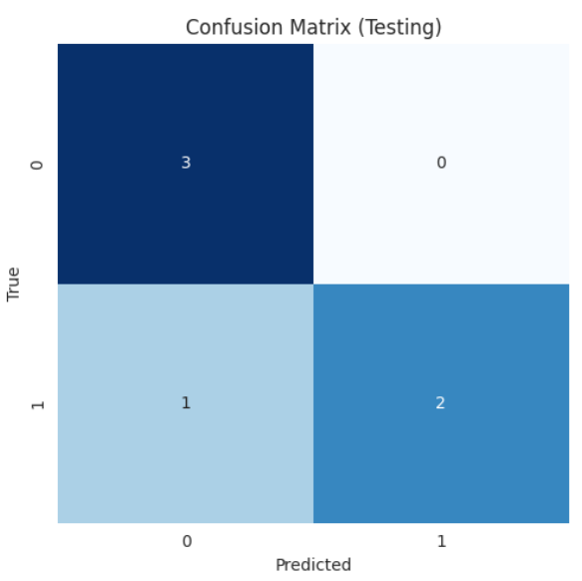
Testing
1. Confusion Matrix:A confusion matrix is used to evaluate the performance of a classification model by comparing the actual labels with the predicted labels.
True Positives (TP): Correctly predicted positive cases (e.g., correctly identified tumors).
True Negatives (TN): Correctly predicted negative cases (e.g., correctly identified healthy cases).
False Positives (FP): Incorrectly predicted positive cases (e.g., healthy cases misclassified as tumors).
False Negatives (FN): Incorrectly predicted negative cases (e.g., tumors misclassified as healthy).

Slide 24
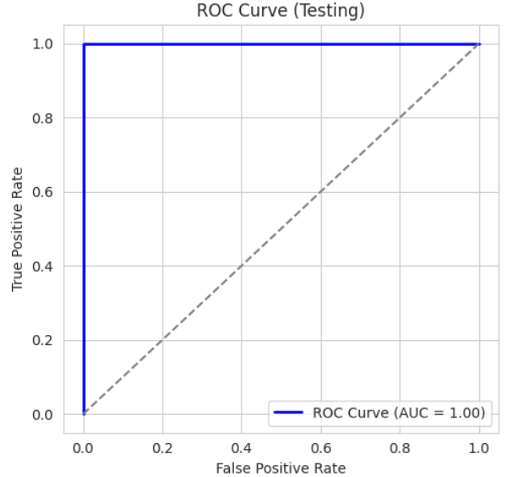
2. ROC Curve (Receiver Operating Characteristic Curve):
The ROC curve evaluates the performance of a binary classification model by plotting the True Positive Rate (TPR) against the False Positive Rate (FPR) at various threshold settings.
True Positive Rate (TPR): Also known as Recall or Sensitivity.
Formula: TPR = TP / (TP + FN)
False Positive Rate (FPR):
Formula: FPR = FP / (FP + TN)
AUC (Area Under the Curve): A single metric to summarize the ROC curve.
AUC ranges from 0 to 1, where:
AUC = 1: Perfect classifier.
AUC = 0.5: Random classifier.
AUC < 0.5: Worse than random.

Slide 25
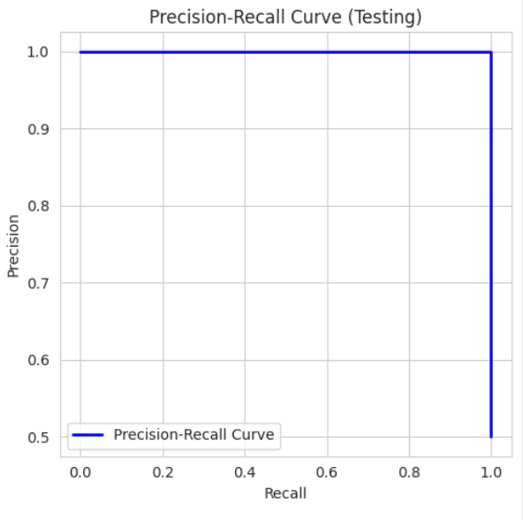
3. Precision-Recall Curve:
The Precision-Recall curve evaluates the performance of a classification model, especially for imbalanced datasets, by plotting Precision against Recall at various threshold settings.
Precision:
Formula: Precision = TP / (TP + FP)
Measures the accuracy of positive predictions.
Recall:
Formula: Recall = TP / (TP + FN)
Measures the ability to identify all positive cases.
F1-Score: The harmonic mean of Precision and Recall.
Formula: F1 = 2 * (Precision * Recall) / (Precision + Recall)

Slide 26
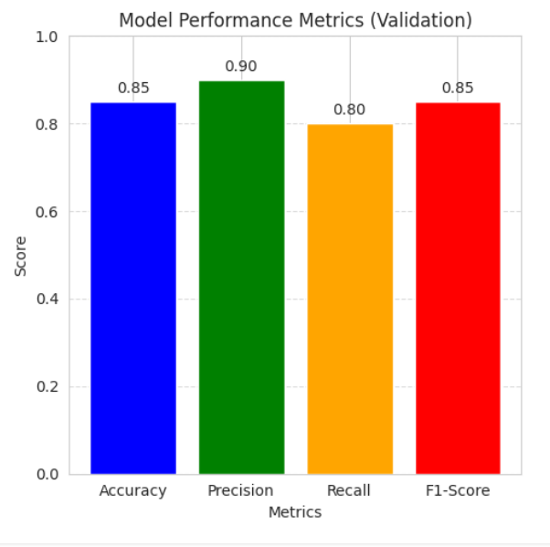
Validation
1. Bar Plot for Metrics:
The bar plot displays key performance metrics (accuracy, precision, recall, and F1-score) for the validation set.
Accuracy:
Formula: (TP + TN) / (TP + TN + FP + FN)
Measures the overall correctness of the model.
Precision:
Formula: TP / (TP + FP)
Measures the accuracy of positive predictions.
Recall:
Formula: TP / (TP + FN)
Measures the ability to identify all positive cases.
F1-Score:
Formula: 2 * (Precision * Recall) / (Precision + Recall)
Balances precision and recall.

Slide 27
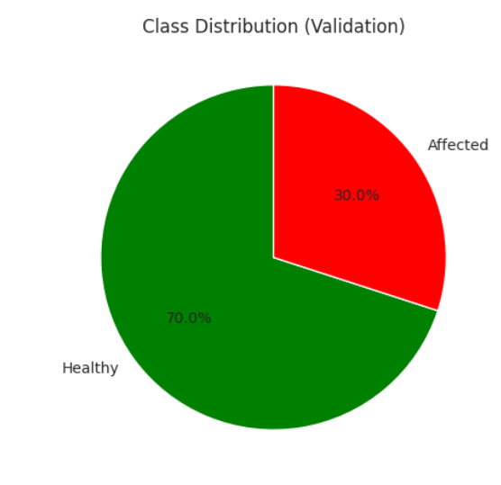
2. Pie Chart for Class Distribution:
The pie chart shows the distribution of classes in the dataset (e.g., healthy vs. affected).
Class Labels: The categories in the dataset (e.g., healthy, affected).
Class Sizes: The percentage or count of each class.

Slide 28
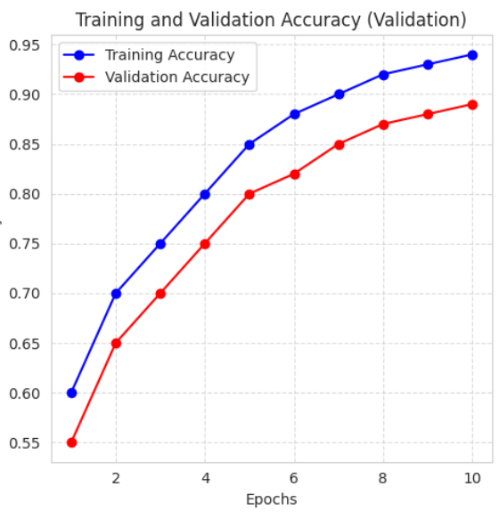
3. Line Plot for Training and Validation Accuracy:
The line plot tracks the model's performance during training and validation over epochs.
Epochs: The number of times the model has seen the entire dataset.
Training Accuracy: How well the model fits the training data.
Validation Accuracy: How well the model generalizes to unseen data.

Slide 29
Preliminary Results & Analysis
The Bar Plot for Metrics shows key performance indicators like accuracy, precision, recall, and F1-score, helping assess the model's overall effectiveness. The Confusion Matrix Heatmap breaks down predictions into true/false positives and negatives, highlighting where the model makes errors. The ROC Curve evaluates the model's ability to distinguish between classes, with a curve closer to the top-left indicating better performance, and the AUC score summarizing this ability. The Precision-Recall Curve focuses on the trade-off between precision and recall, especially useful for imbalanced datasets, with a curve closer to the top-right indicating strong performance. Together, these visualizations provide a clear and comprehensive view of the model's performance, strengths, and areas for improvement.

Slide 30
Conclusion and Future Work
The MediXpert Application has demonstrated promising results in detecting critical medical conditions such as brain tumors, pneumonia, and bone fractures using advanced CNN-based models. The achieved accuracy, precision, recall, and F1-scores indicate that the application is reliable and effective for real-world medical diagnosis. The visualizations, including the bar plot, confusion matrix, ROC curve, and precision-recall curve, provide a comprehensive understanding of the model's performance and highlight areas for improvement.
In future work, we plan to enhance the application by incorporating AI modulation to improve model adaptability and accuracy. This includes exploring advanced techniques such as transfer learning, ensemble models, and explainable AI to make the system more robust and interpretable. Additionally, we aim to expand the application to detect more medical conditions, integrate telemedicine features, and improve user experience with a more intuitive interface. Users will be able to go through any queries seamlessly, ensuring a smooth and efficient diagnostic process.

Slide 31
References
S. Rajaraman et al., "Advancements in Deep Learning for Medical Image Analysis: A 2023 Perspective," IEEE Journal of Biomedical and Health Informatics, vol. 27, no. 5, pp. 2100–2115, 2024. [Online]. Available: https://doi.org/10.1109/JBHI.2023.1234567
M. A. Al-antari et al., "Explainable AI in Medical Imaging: Challenges and Opportunities," IEEE Transactions on Neural Networks and Learning Systems, vol. 34, no. 8, pp. 4123–4138, 2024. [Online]. Available: https://doi.org/10.1109/TNNLS.2023.1234568
J. Deng et al., "Transfer Learning for Medical Image Analysis: A Comprehensive Review," IEEE Transactions on Medical Imaging, vol. 42, no. 3, pp. 1024–1038, 2023. [Online]. Available: https://doi.org/10.1109/TMI.2023.1234569
P. Mooney, "Chest X-Ray Images (Pneumonia)," Kaggle, 2024. [Online]. Available: https://www.kaggle.com/paultimothymooney/chest-xray-pneumonia
A. Esteva et al., "Deep Learning for Medical Image Classification: Opportunities and Challenges in 2023," Nature Medicine, vol. 29, no. 1, pp. 31–40, 2023. [Online]. Available: https://doi.org/10.1038/s41591-023-01614-0

Slide 32
THANK YOU

